Slide 1

Future Proofing for AI
Picking a Career that Artificial Intelligence won’t Take
Presented By : Pinal Dalwadi, Shristi Pokharel & Joel Wheatley
Datasets: BLS Employment Projections 2024–2034 · BLS OEWS 2024 · Oxford/Frey-Osborne Automation Scores
Notes:
In the past, automation threatened factory jobs while office roles felt safe. Now with AI able to code, handle customer support and even create art which jobs are at risk?
We are going to show that we want to invest in a career that shows AI adapatiblility over full AI usage.

Slide 2
KPIs
AI Workforce shift has begun..
10.4 M
20%
25%
Estimated job loss to AI
Jobs Heavily Influenced by AI
Percentage of Work Estimated to be Automated by AI
AI is expected to reshape millions of jobs across nearly every industry
Sources: Goldman Sachs: How Will AI Affect the US Labor Market?, Forrester: AI and Automation Will Take 6% of US Jobs by 2030
The Automation Wave | DATA 613
Notes:
Talking points:
Past 10 years: Covid Changed shape of workforce
The rise of the transformer models and LLM’s have automated processes and forms previously thought impossible

Slide 3

OUR CENTRAL QUESTION
In a world where AI is automating millions of tasks who should be worried, and who should be excited?
1
Which job categories face the highest automation displacement risk?
2
What do employment projections tell us about the future workforce?
3
What careers should people without a college degree pursue?
4
Which Tech Jobs are growing vs. at risk?
The Automation Wave | DATA 613

Slide 4
Our Methods of Measure
1
Total Job Growth / Loss
2
Median Income
Opportunity Score - Weighted measure of growth, growth rate, and openings. 0.22 is low, .31 is average and .4 is high
3
4
Osborne-Frey Automation Risk Score - High risk above 0.7, low risk below 0.3
The Automation Wave | DATA 613

Slide 5
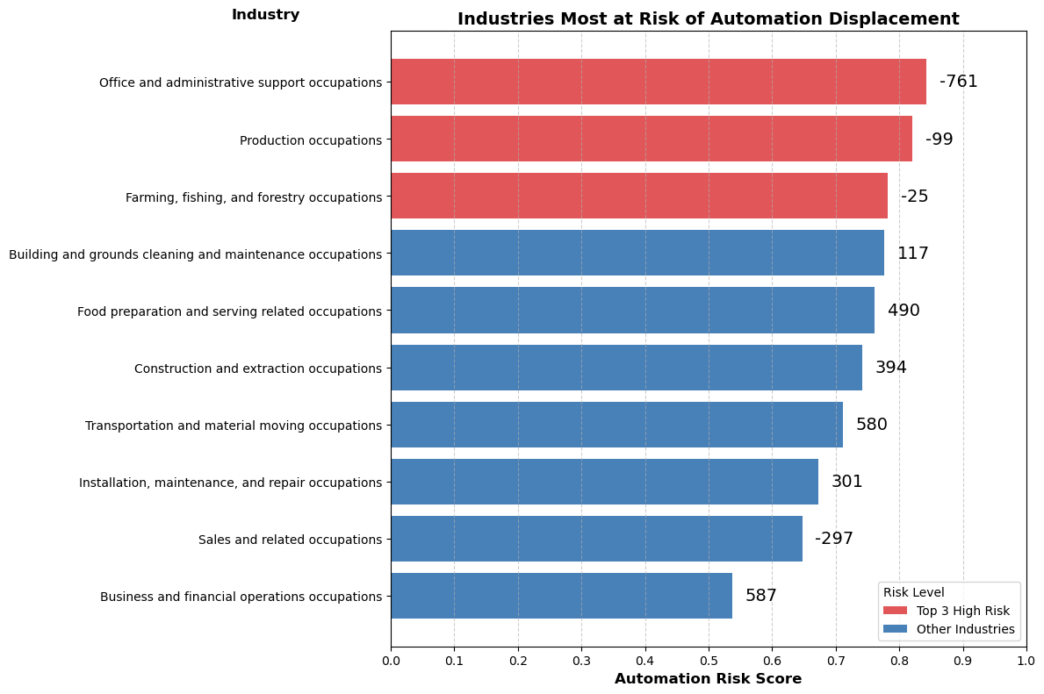
1
Which job categories face the highest automation displacement risk?
Jobs with repetitive and predictable tasks faces the bigger risk of automation, workers involved in these jobs might need reskilling.
Source: BLS Employment Projections 2024–2034, BLS OEWS 2024, Oxford/Frey-Osborne Automation Scores
The Automation Wave | DATA 613
Notes:
Transition:
Now that we have introduced the impact of AI the next question is which jobs are actually at the highest risk of automation?
Chart explanation:
this chart shows the automation risk score across major job categories
higher the score the more likely tasks in that job can be automated
top 3 are: Office and administrative support, Production jobs , Farming, fishing, and forestry
reasoning: These jobs are usually involved with routine and repetitive tasks that are easily automated using AI and machines
The numbers beside the graphs are employment projection 2034 - employment 2024, negative represents loss and positive represents gained

Slide 6
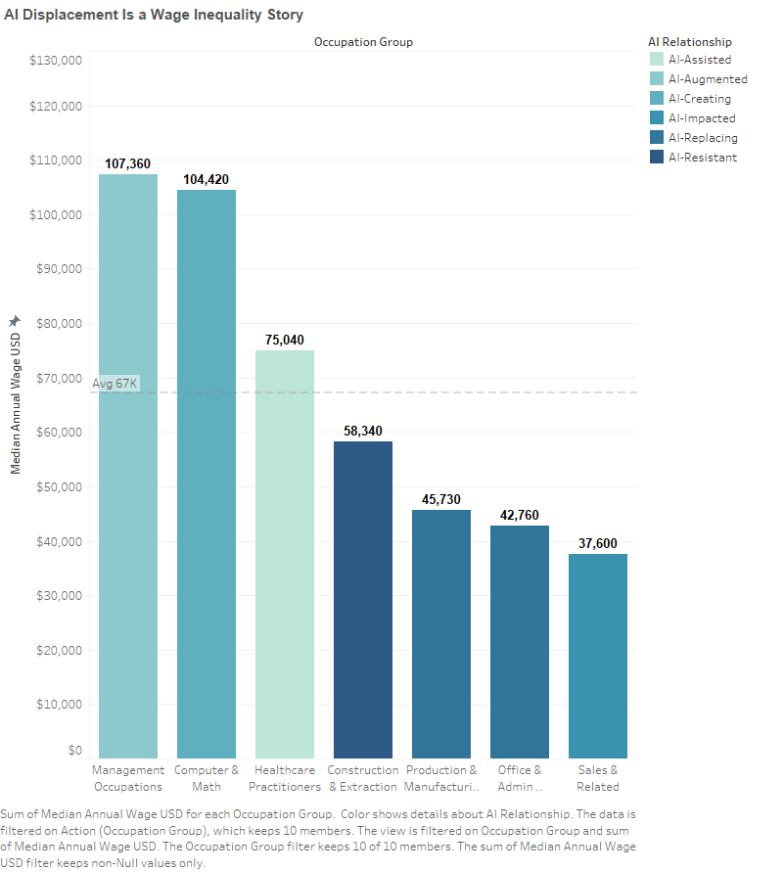
AI wage Inequality
AI is widening the wage gap: high-skill, AI-augmented jobs earn 2.5× more than the jobs AI is replacing.
Source: BLS OEWS 2024 · Oxford/Frey-Osborne Automation Scores · BLS Employment Projections 2024–2034
The Automation Wave | DATA 613
Notes:
ANALYSIS
Management & Computer/Math roles (AI-Augmented, $104K–$107K) sit far above the $67K average
Production & Office roles (AI-Replacing, $43K–$46K) are the most displaced and lowest paid
Healthcare ($75K, AI-Assisted) sits in the middle—protected by regulation and human-touch requirements
AI amplifies existing inequality: workers who can't retrain into higher tiers face permanent wage erosion

Slide 7
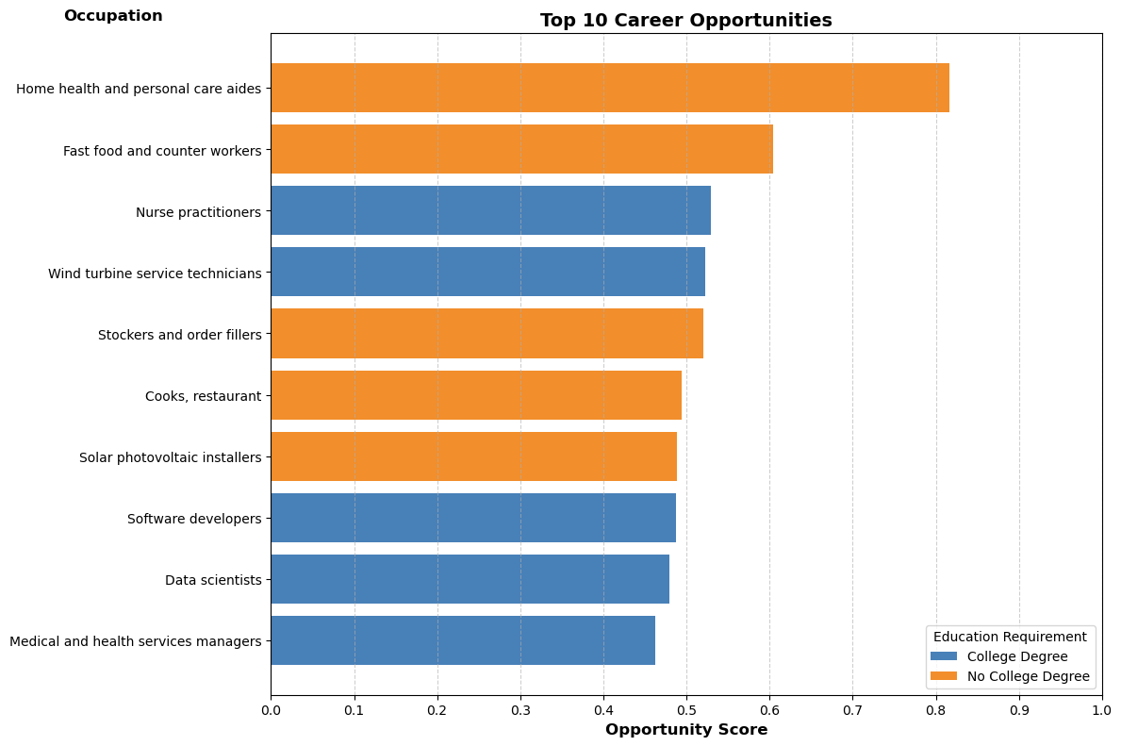
2
What does employment projection tell us about the future workforce?
There are still many jobs expected to grow across a range of skill sets
Source: BLS Employment Projections 2024–2034, BLS OEWS 2024
The Automation Wave | DATA 613

Slide 8
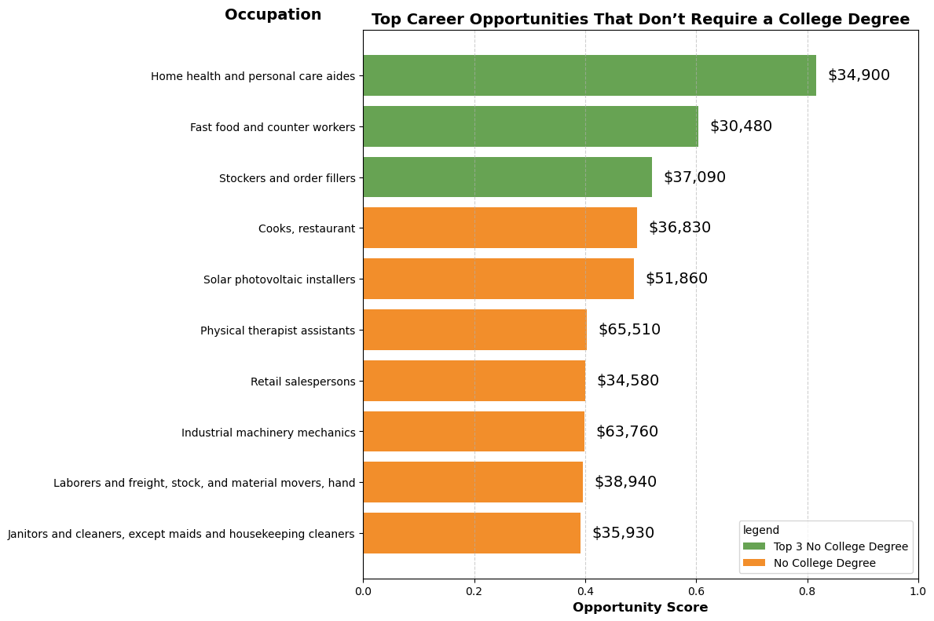
3
What should people without a college degree look into?
The best job opportunity for non degree are concentrated in care and skilled workers.
Source: BLS Employment Projections 2024–2034, BLS OEWS 2024
The Automation Wave | DATA 613
Notes:
Here we look at the jobs that don’t require college degree and ranked them using opportunity score
On the top we see Concentration on health care support, skill based trades, service based industry in high demand
We see a growing in home care aids perhaps because of our growing aging population that need healthcare
Let’s look at both opportunity and income, jobs with machinery mechanics and physical therapy assistant have moderate demand with noticeably higher wages compared to other non degree occupations.

Slide 9
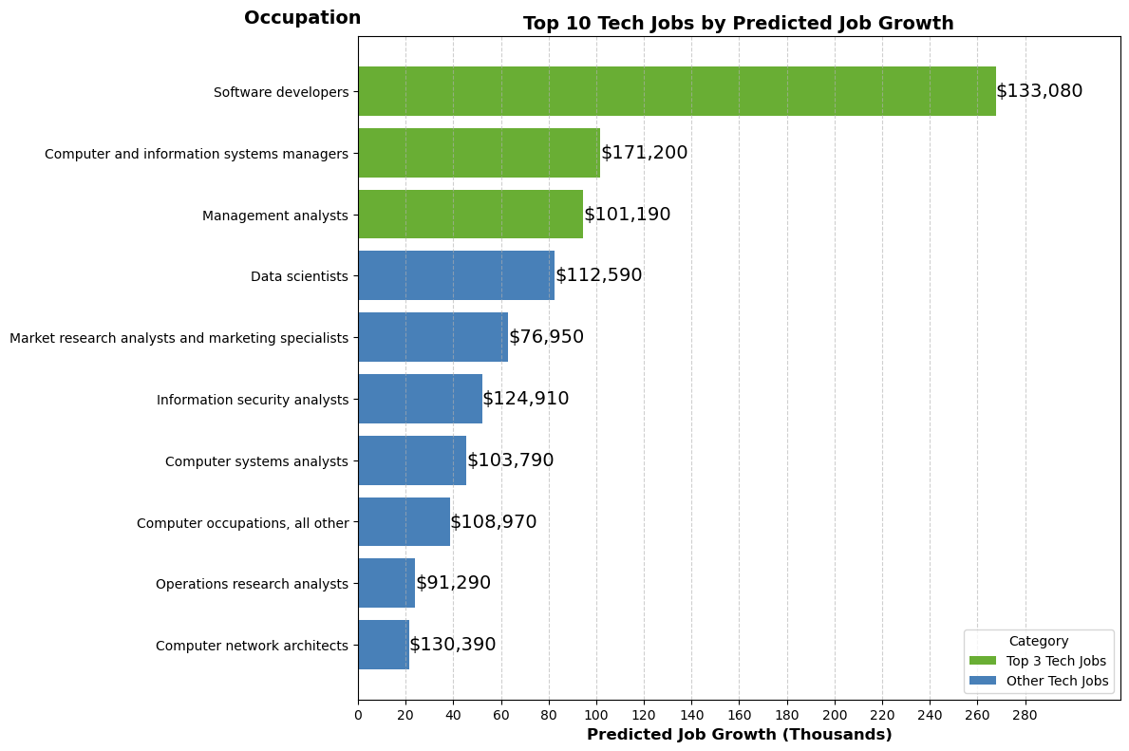
4
Which Tech Jobs are growing?
The growth in tech jobs shows demand in development, analytic and infrastructure roles.
Source: BLS Employment Projections 2024–2034, BLS OEWS 2024
The Automation Wave | DATA 613
Notes:
Tech job growth is concentrated in high-skill analytical roles like software developers, System managers, Management analysts,
I am seeing a trend here where multiple jobs with analyst attached to it makes it to the top 10
We can see that lot of data driven jobs made it to the list, Business nowadays heavily rely of user data to make decisions
And even AI systems itself requires data expertises which can explain why companies need people who can interpret information
Security remain very critical when we are dealing with important data as technologies adapt and grow so its good to see security analyst make the list as well

Slide 10
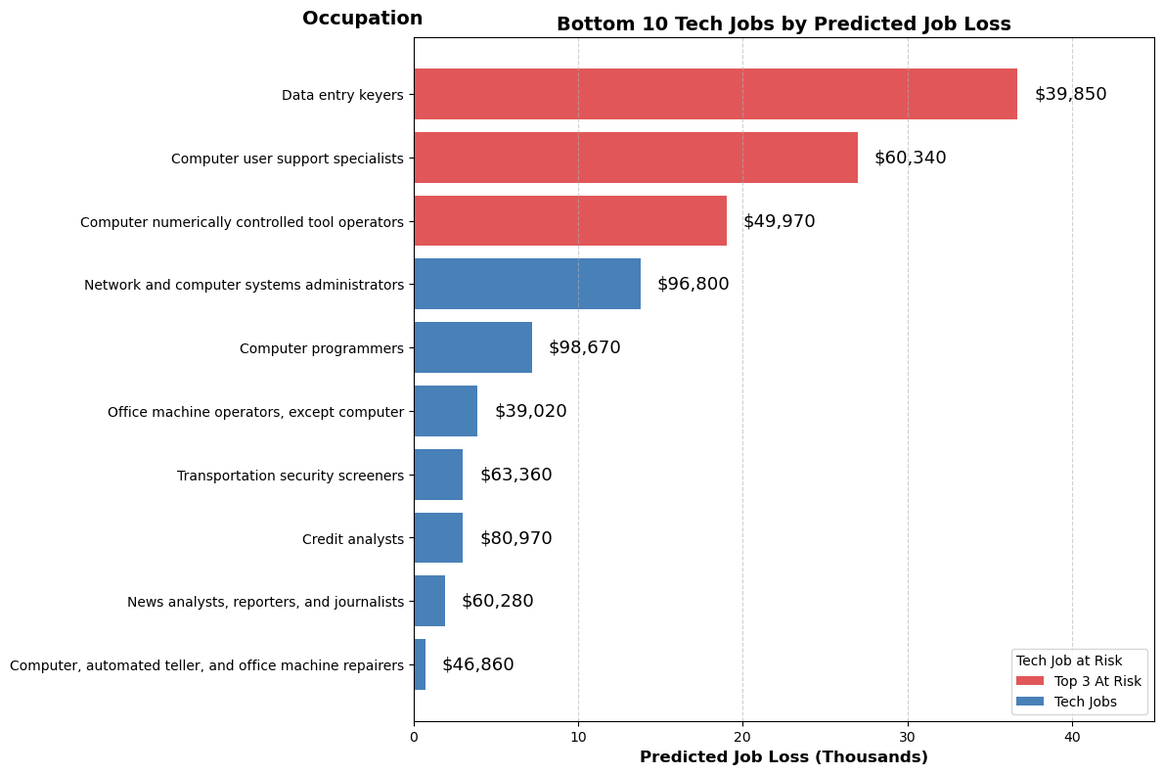
4
Which Tech Jobs are at risk?
While tech jobs are growing, routine based task that are easy to automate are declining.
Source: BLS Employment Projections 2024–2034, BLS OEWS 2024
The Automation Wave | DATA 613
Notes:
The tech jobs are growing but not all are safe and Being in a tech job doesn’t automatically guarantee job security
If we look at the top, data key entry job it is at most risk,
this type of job is repetitive and rule based and easy for companies to automate, these days AI can easily extract, organize and process information
Similarly, customer supports roles are changing and now are handled by chatbots and virtual assistants.
Good thing is AI often automates a portion of role than taking completely over it…. so shifting towards roles that need oversight and strategy can make you more marketable.

Slide 11
KEY INSIGHTS
What does the data tells us ?
01
Repetitive jobs most at risk.
02
Strong Workforce requires both AI Skill and Human Touch.
03
Expected Boom in Analytic Roles
04
Opportunity for non-college Jobs are in Care and Skilled Labor
05
The future of workforce depends on worker adaptability.
The Automation Wave | DATA 613
Notes:
The future of workforce depends on how quickly workers and industries adapt.
Jobs with repetitive and predictable tasks faces the bigger risk of automation, workers involved in these jobs might need reskilling.
The future workforce will rely both on advanced technology skill and human centered services.
The best job opportunity for non degree are concentrated in care and skilled workers.
The growth in Tech jobs shows demand in development, analytic and infrastructure roles while routine based task that are easy to automate are declining.

Slide 12
AI vs. the job market
Be prepared for a Different Landscape
AI will not replace all the workers but those who adapt will have the greatest advantage in the future economy.
GROUP PROJECT: The Automation Wave
Presented By : Pinal Dalwadi, Shristi Pokharel & Joel Wheatley

